Slide 1

MeplannererApp
Imran Durowoju

Slide 2


Criteria
General organiser
Ability to take notes
Ability to set and mark tasks as done
Ability to hold and manage contact list
Target Audience
Technology-able
Busy schedules
8+ years old
Industry Examples
Outlook, OneNote etc
Gmail, Google Keep Notes
Functional Requirements
Task Management:
Ability to add, edit, delete tasks
Calendar Integration:
Calendar available for scheduling and reminders
Weather Integration:
Ability to check the weather for the day
Note-taking facility:
Ability to write and save notes
Non-Functional Requirements
Performance:
App should respond quickly
Usability:
User-friendly interface for ease of navigation and task management
Reliability:
Functioning without significant errors or crashes
Compatibility:
Support across various devices and operating systems

Slide 3
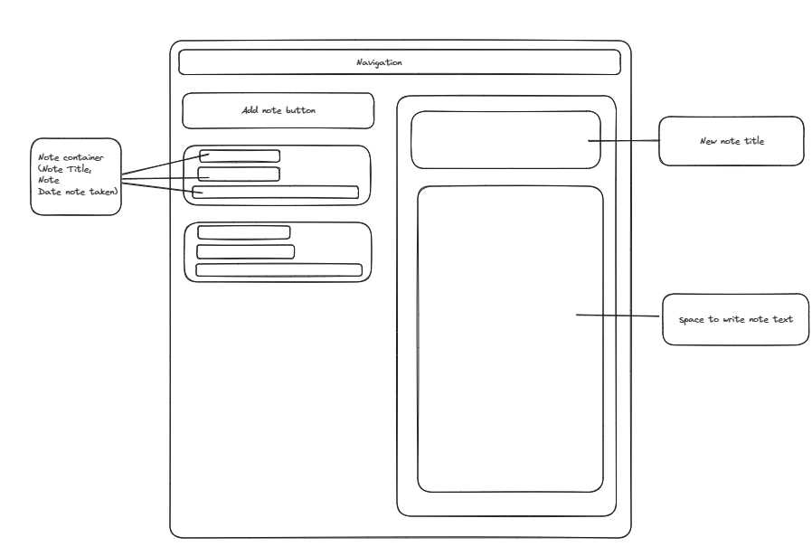
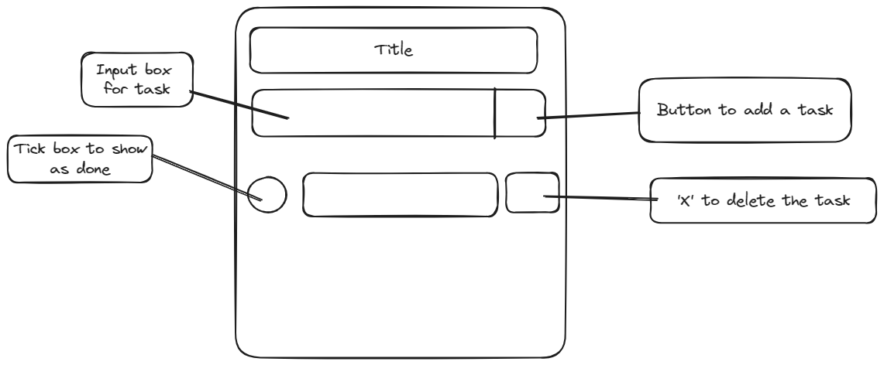
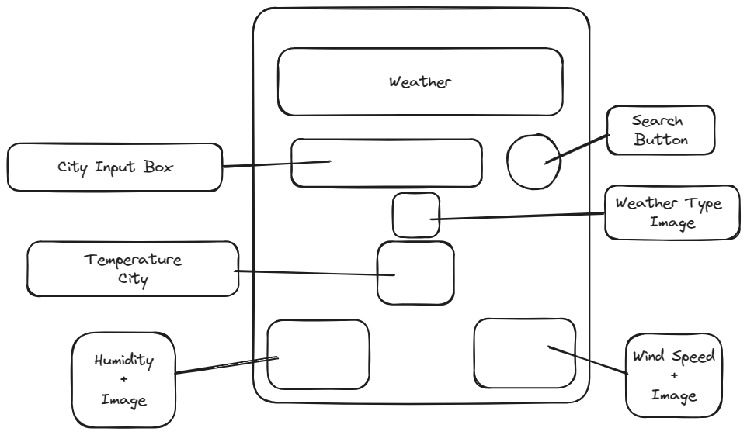
Homepage
To-do List
Weather

Slide 4
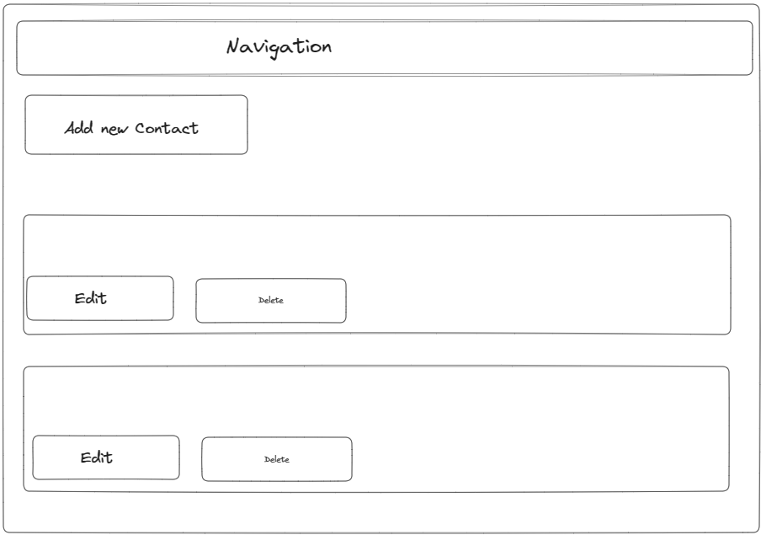
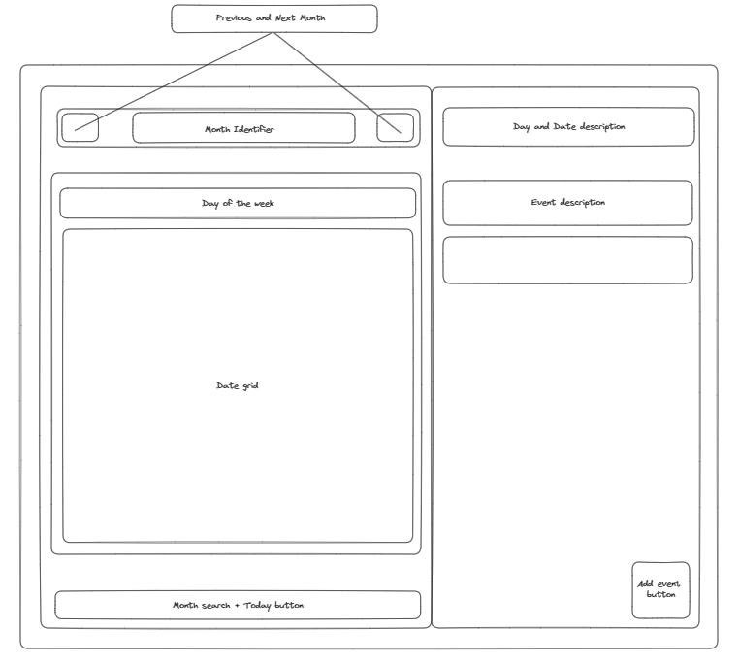
Contacts
Calendar

Slide 5
DEMO

Slide 6
Future Direction
Possibility to improve user experience by developing in dashboard with all components on one page.
Ability to categorise tasks
Full integration of calendar with all other applications
Adding functionality to the ‘Edit’ and ‘Delete’ buttons on the contact list. As well as add a ‘New contact’ button with the added functionality.
Add credential aspect so that users must sign in for access
Look at methods of making this more portable
Notes:
Make sure i talk about the good bit

Slide 7
Thank You

